Slide 1
WHAT’S MISSING???
After all the items are
completed on the Start-Up
Checklist – What’s still needed?

Slide 2
SALES!!!
Where do you start?
When do you start?
What do you say?

Slide 3
Who’s going to do the selling???
You!!!
Notes:
Let’s start with – “Who’s going to do the selling?” You!
Tell story of starting Campagna & trying to always hire someone else to do the selling. Problem was – I needed to be able to sell the salesperson first on my products so they would be enthused & prepared to go make the sales our company needed.

Slide 4
When do you start?
NOW!!!

Slide 5

What do you say?
What you need
is a
PITCH

Slide 6
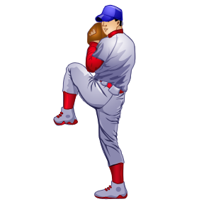
It is NOT:
Baseball
Camping
Yukky stuff under your shingles

Slide 7
Definition:
“ to throw, usually with a particular object, or toward a particular object.”

Slide 8
Purpose of your Pitch:
“Offer something so compelling it begins a conversation,
. . . Brings the other person in(to the conversation) as a participant,

Slide 9
. . . and eventually . . .
. . . (you) arrive at an outcome that appeals to both of you.”
Daniel H Pink,
TO SELL IS HUMAN

Slide 10
In essence,
You want to ENGAGE another PERSON
in a CONVERSATION about
YOUR BUSINESS
that they will REMEMBER
and ACT UPON sometime
in the future.

Slide 11
When crafting your pitch:
Clarify your purpose – engage the listener
Determine your strategy – use words that will support your purpose

Slide 12
After someone hears your pitch:
What do you want them to know?
What do you want them to feel?
What do you want them to do?

